Slide 1

Introduction to
Reinforcement
Learning
Presentation: Baekryun Seong
2024.05.20

Slide 2
Value Function
Deep Reinforcement Learning Algorithms
Deep Learning for Reinforcement Learning
Reinforcement Learning and Supervised Learning
Table of Contents

Slide 3
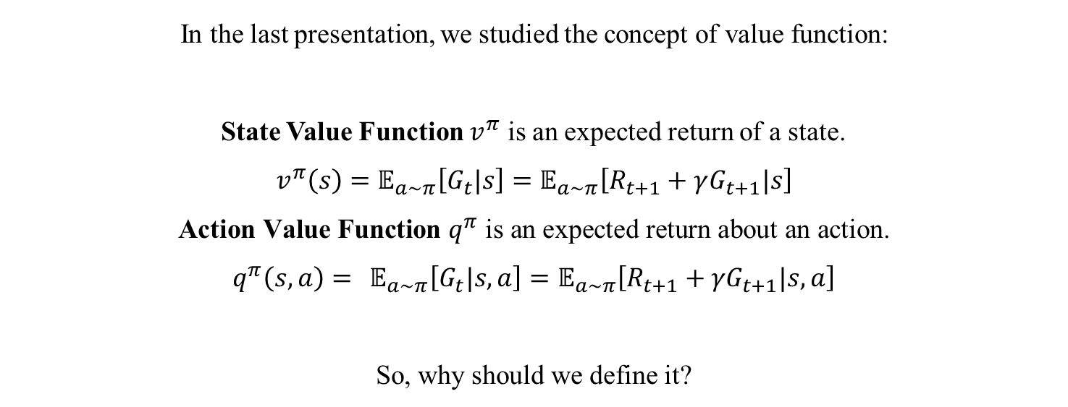
Ch 1.3 State Value Function and Action Value Function
In the last presentation, we studied the concept of value function:
State Value Function $v^{π}$ is an expected return of a state.
$$v^{π}\left(s\right)=𝔼_{a\sim π}\left[G_{t}|s\right]=𝔼_{a\sim π}\left[R_{t+1}+γG_{t+1}|s\right]$$
$$\text{A}\text{ction} \text{Value} \text{Function} q^{π} \text{is} \text{an} \text{expected} \text{return} \text{about} \text{an} \text{action}\text{.}$$
$$q^{π}\left(s,a\right)= 𝔼_{a\sim π}\left[G_{t}|s,a\right]=𝔼_{a\sim π}\left[R_{t+1}+{γG}_{t+1}|s,a\right]$$
So, why should we define it?

Slide 4
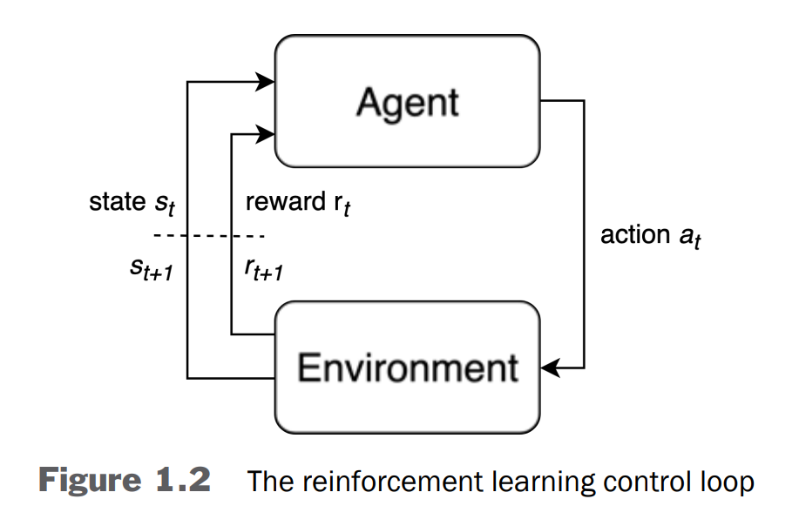
Ch 1.3 Recall: The Reinforcement Learning Control Loop
RL Problems have an objective, which is the sum of rewards received by an agent.
An agent uses the reward signals it receives to reinforce good actions.
Remark: Sum of rewards is expected return, by definition of return. So expected return can be described in value function of a state or action.
To summarize, we use value functions to reinforce good actions.

Slide 5
Ch 1.3 State Value Function Example

Slide 6
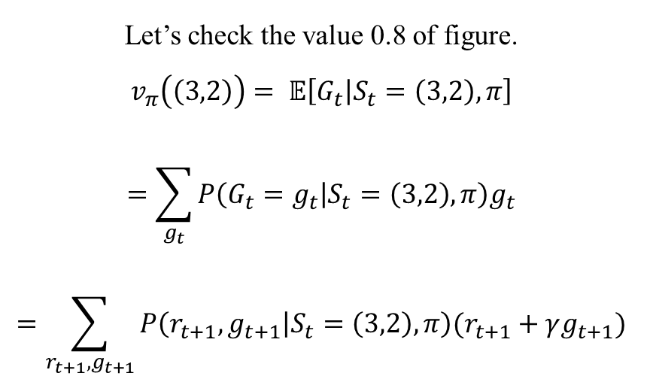
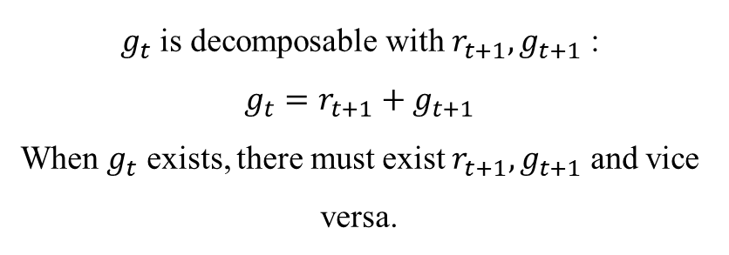
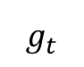
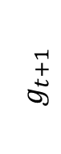
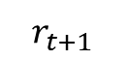
Ch 1.3 State Value Function Example
Let’s check the value 0.8 of figure.
$$v_{π}\left(\left(3,2\right)\right)= 𝔼\left[G_{t} | S_{t}=\left(3,2\right),π\right]$$
$$=\sum_{g_{t}}{P\left(G_{t}=g_{t} | S_{t}=\left(3,2\right),π\right)g_{t}}$$
$$=\sum_{r_{t+1},g_{t+1}}{P\left(r_{t+1}, g_{t+1} | S_{t}=\left(3,2\right),π\right)(r_{t+1}+γg_{t+1})}$$
$$r_{t+1}$$
$$g_{t+1}$$
$g_{t}$ is decomposable with $r_{t+1},g_{t+1}$ :
$$g_{t}=r_{t+1}+g_{t+1}$$
When $g_{t}$ exists, there must exist $r_{t+1},g_{t+1}$ and vice versa.
$$g_{t}$$

Slide 7
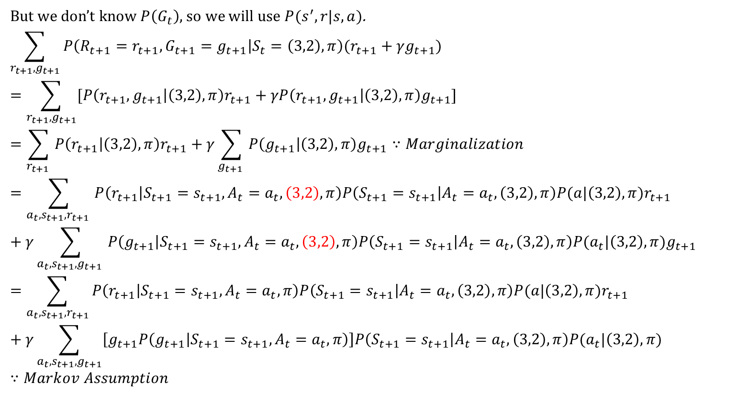
Ch 1.3 State Value Function Example Continued…
But we don’t know $P\left(G_{t}\right)$, so we will use $P(s^{′},r|s,a)$.
$$\sum_{r_{t+1},g_{t+1}}{P\left(R_{t+1}=r_{t+1}, G_{t+1}=g_{t+1} | S_{t}=\left(3,2\right),π\right)(r_{t+1}+γg_{t+1})}$$
$$=\sum_{r_{t+1},g_{t+1}}{[P\left(r_{t+1}, g_{t+1} | \left(3,2\right),π\right)r_{t+1}+γP\left(r_{t+1}, g_{t+1} | \left(3,2\right),π\right)g_{t+1}]}$$
$$=\sum_{r_{t+1} }{P\left(r_{t+1} | \left(3,2\right),π\right)r_{t+1}}+γ\sum_{g_{t+1} }{P\left(g_{t+1} | \left(3,2\right),π\right)g_{t+1}}∵Marginalization$$
$$=\sum_{a_{t},s_{t+1},r_{t+1} }{P\left(r_{t+1} | S_{t+1}=s_{t+1},A_{t}=a_{t},\left(3,2\right),π\right)P\left(S_{t+1}=s_{t+1} | A_{t}=a_{t},\left(3,2\right),π\right)P(a|\left(3,2\right),π)r_{t+1}}+γ\sum_{a_{t},s_{t+1},g_{t+1} }{P\left(g_{t+1} | S_{t+1}=s_{t+1}, A_{t}=a_{t},\left(3,2\right),π\right)P\left(S_{t+1}=s_{t+1} | A_{t}=a_{t}, \left(3,2\right),π\right)P(a_{t}|\left(3,2\right),π)g_{t+1}}$$
$$=\sum_{a_{t},s_{t+1},r_{t+1}}{P\left(r_{t+1} | S_{t+1}=s_{t+1},A_{t}=a_{t},π\right)P\left(S_{t+1}=s_{t+1} | A_{t}=a_{t},\left(3,2\right),π\right)P(a|\left(3,2\right),π)r_{t+1}}+γ\sum_{a_{t},s_{t+1},g_{t+1}}{\left[g_{t+1}P\left(g_{t+1} | S_{t+1}=s_{t+1}, A_{t}=a_{t},π\right)\right]P\left(S_{t+1}=s_{t+1} | A_{t}=a_{t}, \left(3,2\right),π\right)P(a_{t}|\left(3,2\right),π)}∵Markov Assumption$$

Slide 8
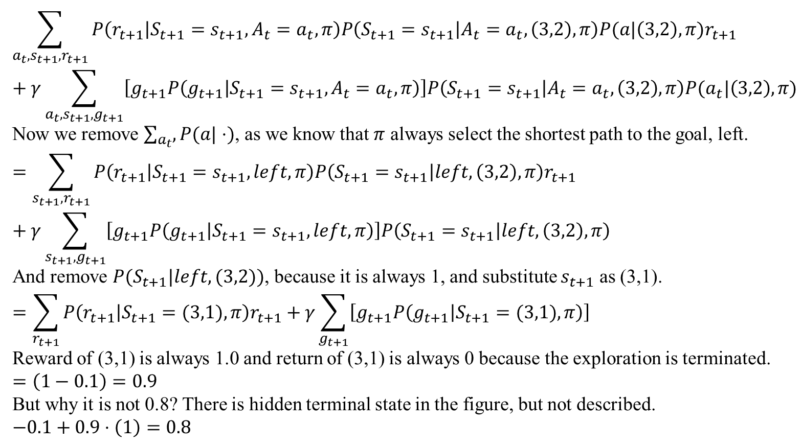
Ch 1.3 State Value Function Example Continued…
$$\sum_{a_{t},s_{t+1},r_{t+1}}{P\left(r_{t+1} | S_{t+1}=s_{t+1},A_{t}=a_{t},π\right)P\left(S_{t+1}=s_{t+1} | A_{t}=a_{t},\left(3,2\right),π\right)P(a|\left(3,2\right),π)r_{t+1}}+γ\sum_{a_{t},s_{t+1},g_{t+1}}{\left[g_{t+1}P\left(g_{t+1} | S_{t+1}=s_{t+1}, A_{t}=a_{t},π\right)\right]P\left(S_{t+1}=s_{t+1} | A_{t}=a_{t}, \left(3,2\right),π\right)P(a_{t}|\left(3,2\right),π)}$$
Now we remove $\sum_{a_{t}}{,P(a|⋅)}$, as we know that $π$ always select the shortest path to the goal, left.
$$=\sum_{s_{t+1},r_{t+1}}{P\left(r_{t+1} | S_{t+1}=s_{t+1},left,π\right)P\left(S_{t+1}=s_{t+1} | left,\left(3,2\right),π\right)r_{t+1}}+γ\sum_{s_{t+1},g_{t+1}}{\left[g_{t+1}P\left(g_{t+1} | S_{t+1}=s_{t+1}, left,π\right)\right]P\left(S_{t+1}=s_{t+1} | left, \left(3,2\right),π\right)}$$
And remove $P(S_{t+1}|left,(3,2))$, because it is always 1, and substitute $s_{t+1}$ as (3,1).
$$=\sum_{r_{t+1}}{P\left(r_{t+1} | S_{t+1}=(3,1),π\right)r_{t+1}}+γ\sum_{g_{t+1}}{\left[g_{t+1}P\left(g_{t+1} | S_{t+1}=(3,1),π\right)\right]}$$
Reward of (3,1) is always 1.0 and return of (3,1) is always 0 because the exploration is terminated.
$$=\left(1−0.1\right)=0.9$$
But why it is not 0.8? There is hidden terminal state in the figure, but not described.
$$−0.1+0.9⋅\left(1\right)=0.8$$

Slide 9
Ch 1.4
Deep Reinforcement Learning Algorithms

Slide 10
Ch 1.4 Deep Reinforcement Learning Algorithms
Reinforcement learning is a problem of determining policy over a given environment.
So, how can we get the good policy?

Slide 11
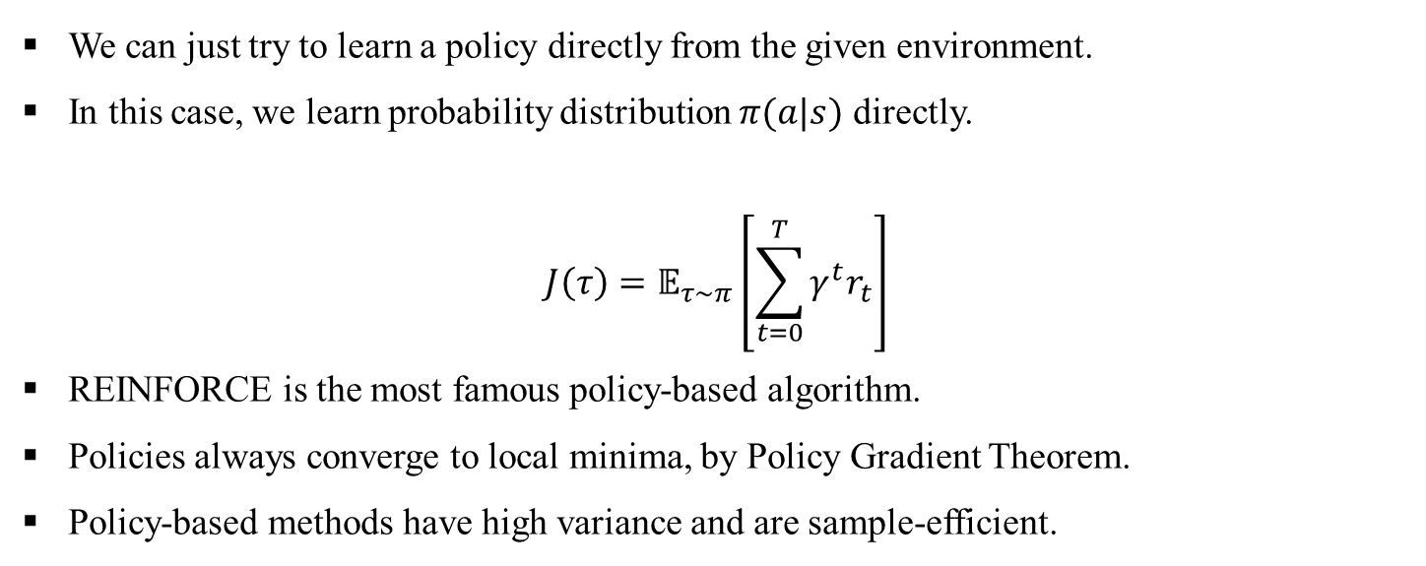
Ch 1.4.1 Policy-Based Algorithms
We can just try to learn a policy directly from the given environment.
In this case, we learn probability distribution $π(a|s)$ directly.
$$J\left(τ\right)=𝔼_{τ\sim π}\left[\sum_{t=0}^{T}{γ^{t}r_{t}}\right]$$
REINFORCE is the most famous policy-based algorithm.
Policies always converge to local minima, by Policy Gradient Theorem.
Policy-based methods have high variance and are sample-efficient.

Slide 12
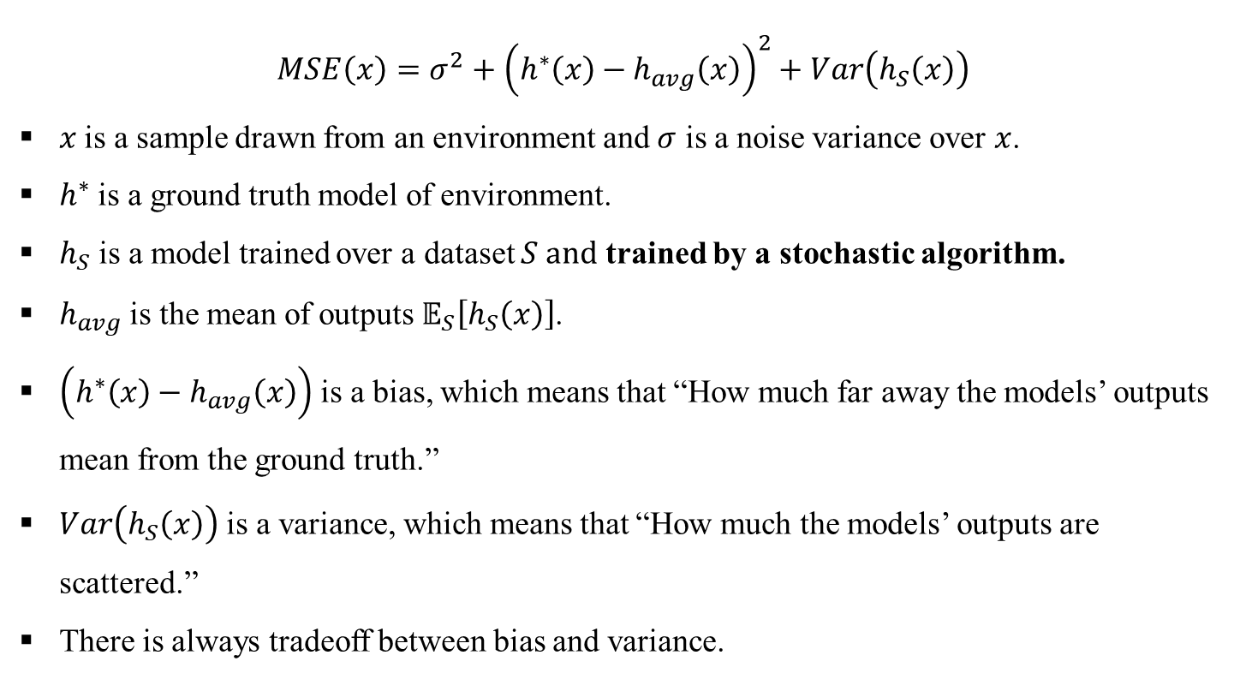
Ch 1.4.1 Wait, what’s the bias and variance of model?
$$MSE\left(x\right)=σ^{2}+{\left(h^{∗}\left(x\right)−h_{avg}\left(x\right)\right)}^{2}+Var\left(h_{S}\left(x\right)\right)$$
$x$ is a sample drawn from an environment and $σ$ is a noise variance over $x$.
$h^{∗}$ is a ground truth model of environment.
$h_{S}$ is a model trained over a dataset $S and$ trained by a stochastic algorithm.
$h_{avg}$ is the mean of outputs $𝔼_{S}\left[h_{S}\left(x\right)\right]$.
$\left(h^{∗}\left(x\right)−h_{avg}\left(x\right)\right)$ is a bias, which means that “How much far away the models’ outputs mean from the ground truth.”
$Var\left(h_{S}\left(x\right)\right)$ is a variance, which means that “How much the models’ outputs are scattered.”
There is always tradeoff between bias and variance.

Slide 13
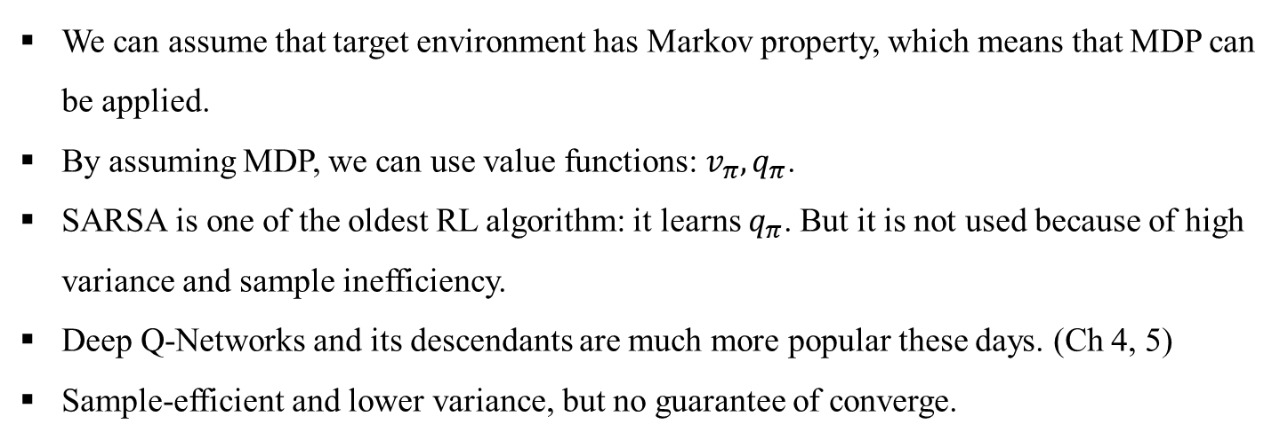
Ch 1.4.2 Value-Based Algorithms
We can assume that target environment has Markov property, which means that MDP can be applied.
By assuming MDP, we can use value functions: $v_{π},q_{π}$.
SARSA is one of the oldest RL algorithm: it learns $q_{π}$. But it is not used because of high variance and sample inefficiency.
Deep Q-Networks and its descendants are much more popular these days. (Ch 4, 5)
Sample-efficient and lower variance, but no guarantee of converge.

Slide 14
Ch 1.4.3 Model-Based Algorithms
If we have the dynamics of the target environment, we can utilize it. E.g. Games
Monte Carlo Tree Search (MCTS) is a well-known model-based method that can be applied to problems with deterministic discrete state spaces. E.g. Go programs.
Linear Quadratic Regulators (iLQR) [79] or Model Predictive Control (MPC), involve learning the transition dynamics.
In robotics. Compared to policy-based or value-based methods, these algorithms also tend to require many fewer samples of data to learn good policies.
However, for most problems, models are hard to come by. Many environments are stochastic, and their transition dynamics are not known.
The distinction between model-based and model-free is also used to classify reinforcement learning algorithms.

Slide 15
Ch 1.4.4 Combined Algorithms: Actor-Critic
We can combine policy-based and value-based. It is called Actor-Critic.
Actor-critic algorithms’ area is under development.
Trust Region Policy Optimization, Proximal Policy Optimization are the examples of actor-critic.
We can also combine model-based and others.
AlphaGo combines MCTS, state value and policy-based.
Dyna-Q iteratively learns the environment and train action-value function.

Slide 16
Ch 1.4.6 On-Policy and Off-Policy Algorithms
On-policy algorithms only utilized data generated from the current policy.
E.g. REINFORCE, SARSA, actor-critic, PPO
Off-policy algorithms additionally utilize data not generated from the current policy. It is sample efficient.
E.g. DQN and its extensions.

Slide 17
Ch 1.5
Deep Learning for Reinforcement Learning

Slide 18
Ch 1.5 Deep Learning for Reinforcement Learning
Deep learning can approximate the function.
Any input and label pair are given in advance: the neural network interacts with environment.
Previous input affects later output: it makes hard to apply gradient descent.

Slide 19
Ch 1.6
Reinforcement Learning and Supervised Learning

Slide 20
Ch 1.6 Reinforcement Learning and Supervised Learning
There are many differences between supervised learning (SL) and reinforcement learning.
Lack of an oracle
Sparsity of feedback
Data generated during training

Slide 21
Ch 1.6.1~2 Lack of an Oracle and Sparsity of Feedback
We do not know the correct answer in RL.
In SL, labels convey a lot of information. (usually 1 bit per class.)
In RL, we just receive how good or bad the action was. It does not tell us the action was correct.
Often, the reward function of environment is very sparse.
We don’t know whether our previous actions were good or not.
In fact, even if we are given the reward, we cannot specify the actions that evokes positive/negative rewards.
The combination of lack of oracle and sparse feedback makes RL less sample-efficient.

Slide 22
Ch 1.6.3 Data Generation
In SL, just apply a pre-drawn dataset.
In RL, the model interacts with the environment. It makes up feedback loop.

